Slide 1


Session 2021/2022 Semester 2
PRINCIPLES OF DATA SCIENCE (WQD7001)
Alternative Assessment – 02
Group – 02
Prepared By
MD TUHIN HOSSAIN (S2116205)
Master of Data Science
Email: s2116205@siswa.um.edu.my
Phone: +601128005017
Submitted To
DR. ROHANA BINTI MAHMUD
Department of Artificial Intelligence
Faculty of Computer Science & Information Technology

Slide 2
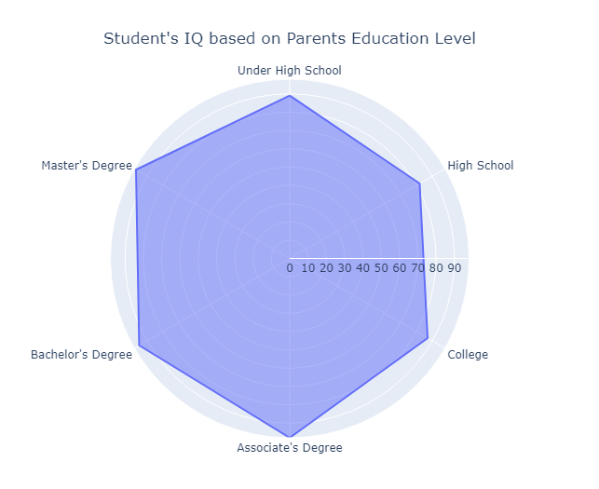
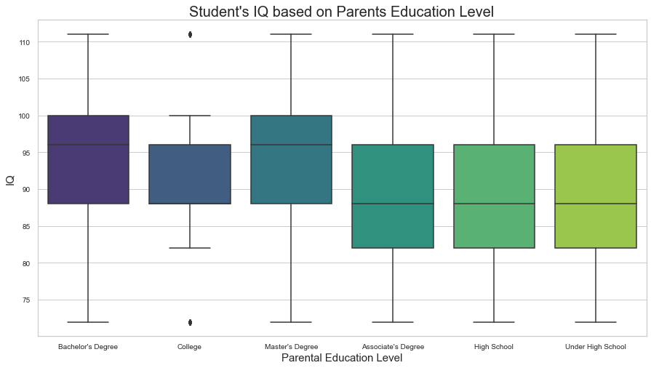
If a student's parents are higher educated then does that affect on student intelligence?
Question: 01 (i)
Answer: From the insights, it is clear that if students' parents are higher educated then student intelligence increases accordingly.

Slide 3
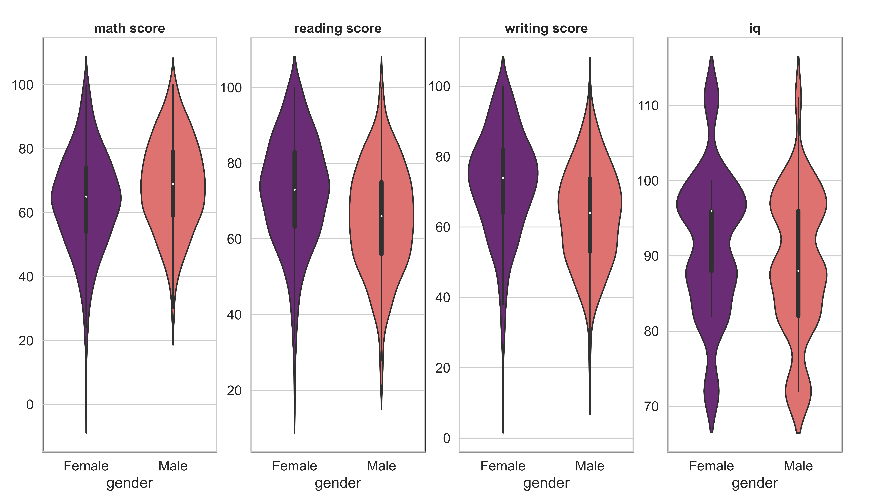
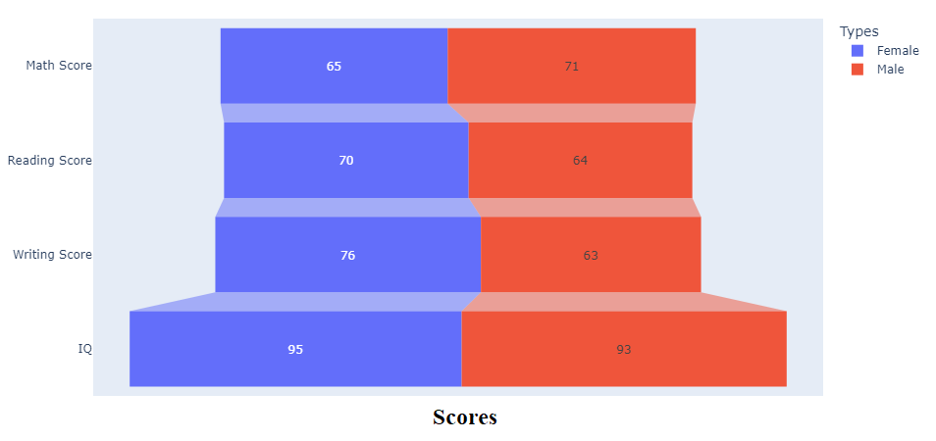
Does student intelligence vary on gender?
Question: 02 (i)
Answer: From the insights, it is clear that males are getting more marks in Math compared to females. On the other hand, females are more efficient in reading and writing compared to males. But male and female both IQ level almost same.

Slide 4
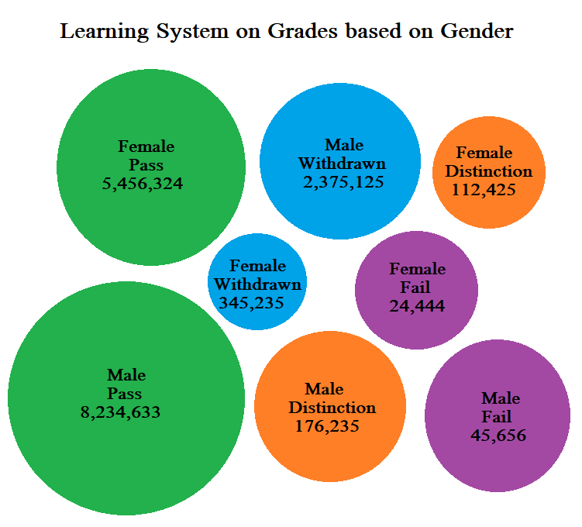
Does Learning Management System help student to excel throughout the course?
Quantitative Chart: 01 (ii)
Quantitative Measurement:
Packed bubbles on students grades throughout course.
Many clicks on the LMS does not ensure better grades.
The data collected throughout few semesters until students graduated.
Hence, improvement on student understanding on courses are more important.

Slide 5
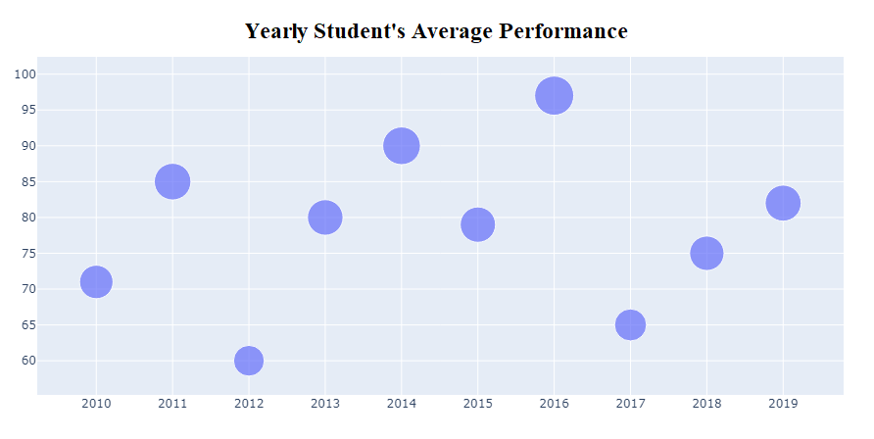
Is the student's performance same in each year?
Quantitative Chart: 02 (ii)
Answer: From the insights, it is clear that in each year student performance is not same.

Slide 6
If students finish their assessments before the deadline then will that help them to achieve good grades on the exam?
Qualitative Chart: 01 (iii)
Answer: From the insights, it is clear that if students finish their assessments timely then it helps them to achieve good grades on the exam.

Slide 7
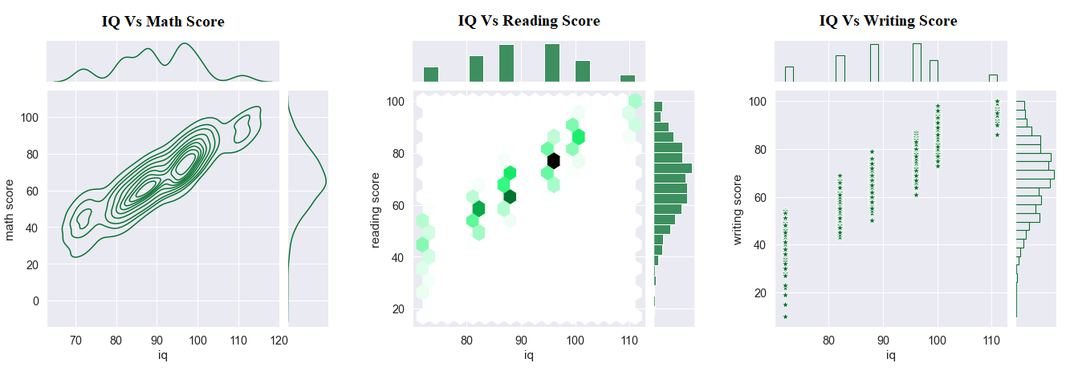
Does IQ score relate to achieving a good score in exam?
Qualitative Chart: 02 (iii)
Answer: From the insights, it is clear that if students' IQ score increases then their test score also increase accordingly.

Slide 8

My GitHub Source Code Repository
https://github.com/tuhinhussain1995/data-science-student-performance
Thank You

